Slide 1


RESEARCH PROPOSAL PRESENTATION
THE IMPACT OF
LARGE LANGUAGE MODELS
IN MEDIA AND ENTERTAINMENT
Maria Ingold
MSc Artificial Intelligence
University of Essex Online
Research Methods and Professional Practice
FIGURE 1 | ChatGPT 4o and human created

Slide 2


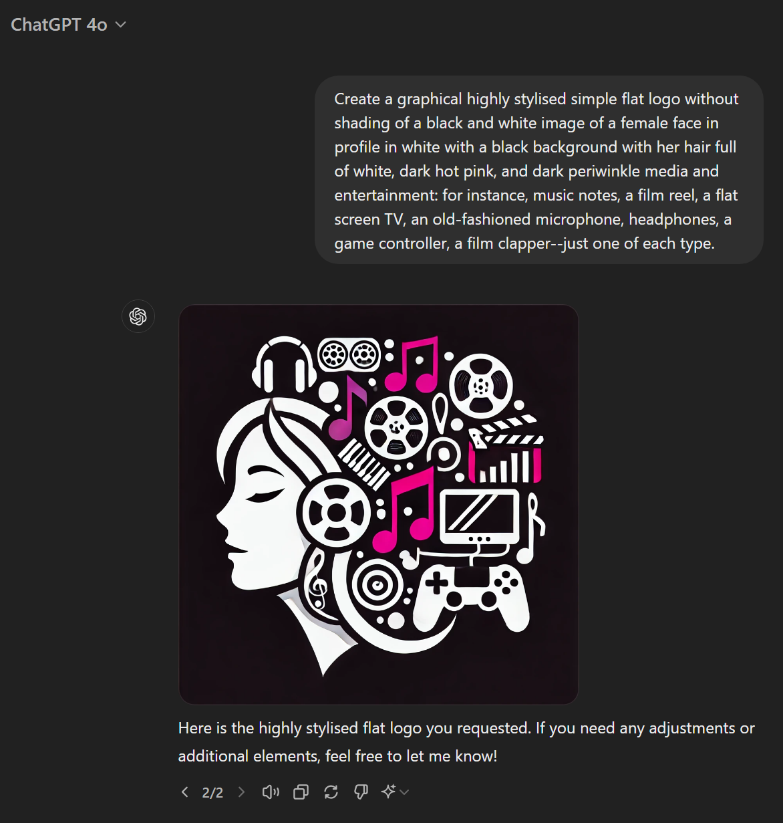
CHATGPT 4o
FIGURE 2 | ChatGPT 4o Large Language Model
Prompt and second generation.
(N.B. Links cannot be provided as only work for account owner.)
FIGURE 3 | Human modified image.
Citation: (OpenAI, 2024)

Slide 3
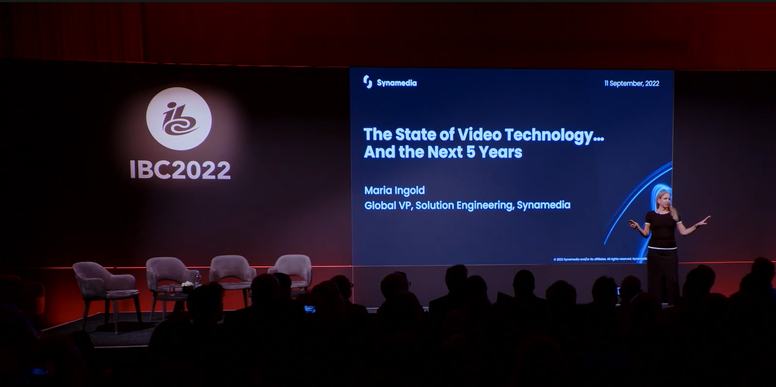
SUITABILITY
Citations: (Dawson, 2015; International Broadcasting Convention, 2022)

Slide 4
SIGNIFICANCE: LLM
Artificial Intelligence (AI)
Deep Learning (DL)
Generative AI
Large Language Model (LLM)
Machine Learning (ML)
Natural Language Processing (NLP)
Neural Networks
Transformers
(ML)
FIGURE 4 | How LLMs fit into AI
Citations: (Vaswani et al., 2017; Hadi et al., 2023; Raiaan et al., 2024)

Slide 5
SIGNIFICANCE: LLM
FIGURE 5 | Example of LLMs in billions of parameters from McCandless et al. (2024) data
Citations: (McCandless et al., 2024; Raiaan et al., 2024; Wu et al., 2024; )

Slide 6
SIGNIFICANCE: M&E
Cinema
Traditional TV
Video Games and
e-Sports
Virtual Reality and Augmented Reality
Internet Advertising
Metaverse
Audio, Music, Radio, and Podcasts
Newspapers, Consumer Magazines and Books
Out-of-Home Advertising
Over-the-Top (OTT) Video
Social Media
Internet access and data consumption
FIGURE 6 | Media and Entertainment (M&E) Subsectors
Citations: (Mordor Intelligence, N.D., Ingold, 2020, PWC, 2023b)

Slide 7
SIGNIFICANCE: M&E GROWTH DECLINE
Cinema
Traditional TV
Video Games and
e-Sports
Virtual Reality and Augmented Reality
Internet Advertising
Metaverse
Audio, Music, Radio, and Podcasts
Newspapers, Consumer Magazines and Books
Out-of-Home Advertising
Over-the-Top (OTT) Video
Social Media
Internet access and data consumption
Forecast
FIGURE 7 | Media and Entertainment (M&E) 2022 Revenue and Projected Annual Growth Decline (PWC, 2023)
Citations: (Chui et al., 2023; PWC, 2023b)

Slide 8
SIGNIFICANCE: LLMS IN M&E
Cinema
Traditional TV
Video Games and
e-Sports
Virtual Reality and Augmented Reality
Internet Advertising
Metaverse
Audio, Music, Radio, and Podcasts
Newspapers, Consumer Magazines and Books
Out-of-Home Advertising
Over-the-Top (OTT) Video
Social Media
Internet access and data consumption
Classic Scenario: LLM for Classic NLP Tasks
Classic Scenario: LLM for Information Retrieval (IR)
Classic Scenario: LLM for Recommendation
Enhanced Capabilities: Multimodal LLMs
Enhanced Capabilities: Knowledge-Graph Enhanced LLM
New Scenarios: LLM-based Agent
New Scenarios: LLM for Evaluation
FIGURE 8 | LLMs in Media and Entertainment (M&E) Subsectors
Citations: (Martino et al., 2023, Zhao et al., 2023)

Slide 9




QUESTION, AIM AND OBJECTIVES
RESEARCH QUESTION: What are the impacts of LLMs across media and entertainment?
AIM: Explore LLM impact in media and entertainment
OBJECTIVES
REVIEW EXISTING LITERATURE
Understand LLMs
Identify LLM use in media and entertainment
DISCOVER LLMS IN MEDIA AND ENTERTAINMENT
Trends, challenges, opportunities
Citations: (Dawson, 2015)

Slide 10
LITERATURE REVIEW: LLM
SCOPE | DOMAIN-SPECIFIC THEMES | MEDIA AND ENTERTAINMENT THEMES | CITATION
Deductive reasoning in LLMs. | None. | None | (Huang & Chen-Chuan Chang, 2022)
LLM advancement and application. | Healthcare, finance, scientific research, law and education. | Social media (training). | (Zhao et al., 2023)
LLM evaluation method review. | Natural science and engineering, medical applications, agent applications, other. | Search and recommendation, game design. | (Chang et al., 2024)
Over 5000 LLM papers synthesis. | Social and humanitarian (25%). Medical and engineering (18%). | Social media and news. | (Fan et al., 2024)
LLM history, technology, and application. | Bio-medical and healthcare, education, social media, business, agriculture. | Social media. | (Raiaan et al., 2024)
TABLE 1 | Media and Entertainment themes in LLM surveys and reviews

Slide 11
LITERATURE REVIEW: LLMS IN M&E
SCOPE | MEDIA AND ENTERTAINMENT THEMES | CITATION
LLM survey with applications. (pre-print) | Subsection General overview: e.g. copy creation Specific LLMs: e.g. Robertuito (Spanish social media) Use cases: e.g. AI-based newscasting Tools: Six | (Hadi et al., 2023)
Generative AI review. | Subsection General overview: e.g. scriptwriting Tools: 77 | (Bengasi et al., 2024)
LLM ethics. | Sentence | (Tokayev, 2023)
TABLE 2 | LLMs and Media and Entertainment
Additional Citations: (Google Scholar, N.D., Page et al., 2021; PWC, 2023b; Parvini, 2024)

Slide 12
LITERATURE REVIEW: PROS AND CONS
BROAD
Public industry report
Broad LLM focus
NARROW
Single sector narrow
MIDDLE
Subsection of broad paper
Broad across M&E (MISSING)
Single sector broad
Understand industry
Good LLM overview
Need granularity
Not sector-specific
Some overview
Lack M&E expertise
Balanced foundation
Neither broad nor narrow
Focused detail
Too granular
Sector big picture
Piece of puzzle
CON PRO TYPE
TABLE 3 | Literature Review: Pros and Cons
Citations: (Google Scholar, N.D.; Chui et al., 2023; PWC, 2023a; Bengesi et al., 2024; Gallotta et al., 2024; Peters & Matz, 2024; Raiaan et al., 2024)

Slide 13
DESIGN AND METHODOLOGY
PROJECT TYPE
(Dawson, 2015)
Research-based
Development
Industry
Problem-Solving
Sequential
Generalised
Circulatory
Evolutionary
PROCESS
(Dawson, 2015; Saunders et al., 2019)
DATA
(Saunders et al., 2019)
Secondary
Primary
REASONING
(Dawson, 2015; Saunders et al., 2019
Inductive
Deductive
METHOD
(QuestionPro, N.D., Saunders et al., 2019)
Qualitative
Quantitative
PURPOSE
(BRM, N.D.; QuestionPro, N.D.; Dawson, 2015; Saunders et al., 2019)
Exploratory
Explanatory (Causal)
Descriptive
Evaluative
Abductive
STRATEGY
(Saunders et al., 2019
Archival Research
Case Study
Ethnography
Action Research
Grounded Theory
Narrative Inquiry
Survey
TIME HORIZON
(Saunders et al., 2019
Cross-Sectional
Longitudinal
Combined
Experiment
PHILOSOPHY
(Saunders et al., 2019)
Interpretivism
Positivism
Critical realism
Postmodernism
Pragmatism
TABLE 4 | Design and Methodology

Slide 14

DESIGN AND METHODOLOGY
DATA COLLECTION
Dawson, 2015; Saunders et al., 2019)
Unstructured
Semi-Structured
Highly Structured
Structured
Large language model(s), media, entertainment
Industry + Academic
2020+
Peer-reviewed
Industry
(private)
Academic
Industry
(public)
TABLE 5 | Data Collection
FIGURE 10 | Data Funnel
FIGURE 9 | Data Sources
Additional Citations: (Google Scholar, N.D.; Dawson, 2015)

Slide 15


ETHICS AND RISK ASSESSMENT
ETHICS
Attribute. Do not plagiarise.
Do not reference non-public data without consent.
Comply usage terms and copyright
Ensure report honestly and objectively.
RISKS
RISK
MITIGATION
Researcher bias
Triangulate (cross-reference)
Researcher error
Triangulate (cross-reference)
Hardware or software failure
Secure cloud backup
Too much or too little data
Narrow or broaden sectors or themes
Citations: (BCS, N.D.; Dawson, 2015, Saunders et al., 2019)

Slide 16
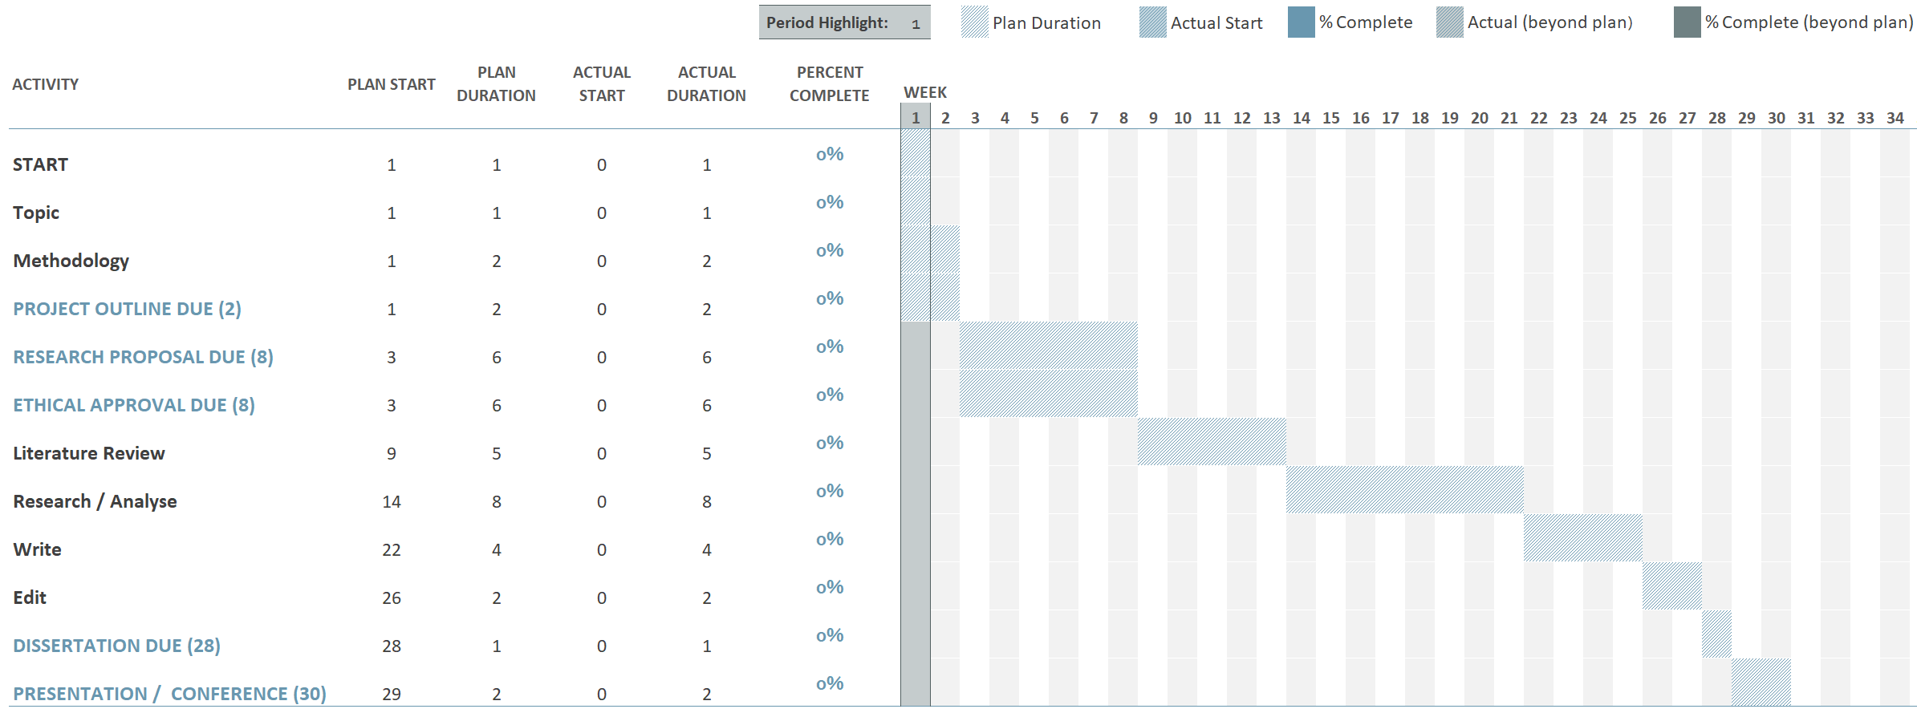
TIMELINE
FIGURE 11 | Gantt chart
Citations: (University of Essex Online, N.Db; Dawson, 2015; Saunders et al., 2019)

Slide 17


ARTEFACTS AND CONCLUSION
RESEARCH REPORT & PRESENTATION
Introduction
Literature Review
Methodology
Findings
Discussion
Conclusion
References
LLMs in M&E industry context
Theories and academic themes
Methods: how and why
Summarise and visualise data
Analysis, themes, issues, opportunities
Foundation for understanding impact
List
TABLE 6 | Report and presentation sections
Citations: (University of Essex Online, N.D.a; Dawson, 2015; PWC, 2023b)

Slide 18
REFERENCES
Bengesi, S., El-Sayed, H., Sarker, M., Houkpati, Y., Irungu, J., & Oladunni, T. (2024) Advancements in Generative AI: A Comprehensive Review of GANs, GPT, Autoencoders, Diffusion Model, and Transformers, IEEE Access 12: 69812–69837. DOI: https://doi.org/10.1109/ACCESS.2024.3397775.
British Computing Society (N.D.) BCS Code of Conduct for members - Ethics for IT professionals | BCS. Available from: https://www.bcs.org/membership-and-registrations/become-a-member/bcs-code-of-conduct [Accessed 3 May 2024].
BRM (N.D.) Research Design. Available from: https://research-methodology.net/research-methodology/research-design/#_ftn2 [Accessed 3 July 2024].
Chang, Y., Wang, X., Wang, J, Wu, Y., Yang, L., Zhu, K., Chen, H., Yi, X., Wang, C., Wang, Y., Ye, W., Zhang, Y., Chang, Y., Yu, P., Yang, Q. & Xie, X. (2024) A Survey on Evaluation of Large Language Models, ACM Transactions on Intelligent Systems and Technology 15(3). DOI: https://doi.org/10.1145/3641289.
Chui, M., Hazan, E., Robers, R., Singla, A., Smaje, K., Sukharevsky, A., Yee, L., Zemmel, R.(2023) The economic potential of generative AI: The next productivity frontier. Available from: https://www.mckinsey.com/capabilities/mckinsey-digital/our-insights/the-economic-potential-of-generative-ai-the-next-productivity-frontier [Accessed 29 July 2023].
Dawson, C.W. (2015) Projects in Computing and Information Systems. 3rd ed. Harlow: Pearson.
Fan, L., Li, L., Ma, Z., Lee, S., Yu, H., & Hemphill, L. (2024) A Bibliometric Review of Large Language Models Research from 2017 to 2023, ACM Transactions on Intelligent Systems and Technology [Preprint]. DOI: https://doi.org/10.1145/3664930.

Slide 19
REFERENCES
Gallotta, R., Todd, G., Zammit, M., Earle, S., Liapis, A., Togelius, J., & Yannakakis, G. (2024) Large Language Models and Games: A Survey and Roadmap. Available from: https://arxiv.org/abs/2402.18659v1 [Accessed 2 July 2024].
Google Scholar (N.D.) Google Scholar. Available from: https://scholar.google.co.uk/ [Accessed 1 July 2024].
Hadi, M., Al-Tashi, Q., Qureshi, R., Shah, A., Muneer, A., Irfan, M., Zafar, A., Shaikh, M., Akhtar, N., Wu, J., Mirjalili, S., Muneer, A. & Ali Al-Garadi, M. (2023) Large Language Models: A Comprehensive Survey of its Applications, Challenges, Limitations, and Future Prospects, Authorea Preprints [Preprint]. DOI: https://doi.org/10.36227/TECHRXIV.23589741.V4.
Huang, J. & Chen-Chuan Chang, K. (2022) Towards Reasoning in Large Language Models: A Survey, Findings of the Association for Computational Linguistics 1049–1065. DOI: https://doi.org/10.18653/v1/2023.findings-acl.67.
Ingold, M. (2020) Tech Expert: Inside OTT, IBC365. Available from: https://www.ibc.org/tech-expert-inside-ott/5399.article [Accessed 10 June 2024].
International Broadcasting Convention (2022) The John Logie Baird Lecture: The State of Video Technology and the Next 5 Years. Available from: https://www.ibc.org/video/the-john-logie-baird-lecture-the-state-of-video-technology-and-the-next-5-years/9086.article [Accessed 29 June 2024].

Slide 20
REFERENCES
Martino, A., Iannelli, M. & Truong, C. (2023) Knowledge Injection to Counter Large Language Model (LLM) Hallucination, Lecture Notes in Computer Science (including subseries Lecture Notes in Artificial Intelligence and Lecture Notes in Bioinformatics) 13998 LNCS: 182–185. DOI: https://doi.org/10.1007/978-3-031-43458-7_34/TABLES/3.
McCandless, D., Evans, T. & Barton, P. (2024) The Rise and Rise of A.I. Large Language Models (LLMs), Information is Beautiful. Available from: https://informationisbeautiful.net/visualizations/the-rise-of-generative-ai-large-language-models-llms-like-chatgpt/ [Accessed 27 June 2024].
Mordor Intelligence (N.D.) Media & Entertainment Market Landscape (2023-2028). Available from: https://www.mordorintelligence.com/industry-reports/media-and-entertainment-market-landscape [Accessed 30 June 2024].
OpenAI (2024) Hello GPT-4o. Available from: https://openai.com/index/hello-gpt-4o/ [Accessed 30 June 2024].
Page, M., McKenzie, J. Bossuyt, P., Boutron, I., Hoffmann, T., Mulrow, C., Shamseer, L., Tetzlaff, J., Akl, E., Brennan, S., Chou, R., Glanville, J., Grimshaw, J., Hróbjartsson, A., Lalu, M., Li, T., Loder, E, Mayo-Wilson, E., McDonald, S., McGuinness, L., Stewart, L., Thomas, J., Tricco, A., Welch, V., Whiting, P. & Moher, D. (2021) The PRISMA 2020 statement: an updated guideline for reporting systematic reviews, BMJ 372. DOI: https://doi.org/10.1136/BMJ.N71.
Parvini, S. (2024) Hollywood’s video game actors want to avoid a strike. The sticking point in their talks? AI, ABC News. Available from: https://abcnews.go.com/Business/wireStory/hollywoods-video-game-actors-avoid-strike-sticking-point-111467875 [Accessed 30 June 2024].

Slide 21
REFERENCES
Peters, H. & Matz, S.C. (2024) Large language models can infer psychological dispositions of social media users, PNAS Nexus 3(6). DOI: https://doi.org/10.1093/PNASNEXUS/PGAE231.
PWC (2023a) Generative AI opportunities for the media and entertainment industry. Available from: https://www.pwc.com/us/en/technology/alliances/library/microsoft-gen-ai-media-entertainment.html [Accessed 2 March 2024].
PWC (2023b) Perspectives from the Global Entertainment & Media Outlook 2023–2027. Available from: https://www.pwc.com/gx/en/industries/tmt/media/outlook/insights-and-perspectives.html [Accessed 30 June 2024].
QuestionPro (N.D.) What is Research - Definition, Types, Methods & Examples. Available from: https://www.questionpro.com/blog/what-is-research/ [Accessed 24 June 2024].
Raiaan, M., Mukta, M., Fatema, K., Fahad, N., Sakib, S., Mim, M., Ahmad, J., Ali, M. & Azam, S. (2024) A Review on Large Language Models: Architectures, Applications, Taxonomies, Open Issues and Challenges, IEEE Access 12: 26839–26874. DOI: https://doi.org/10.1109/ACCESS.2024.3365742.
Saunders, M.N.K., Lewis, P. & Thornhill, A. (2019) Research Methods for Business Students. 8th ed. Pearson.

Slide 22
REFERENCES
Tokayev, K.-J. (2023) Ethical Implications of Large Language Models: A Multidimensional Exploration of Societal, Economic, and Technical Concerns, International Journal of Social Analytics 8(9): 17–33. Available from: https://norislab.com/index.php/ijsa/article/view/42 [Accessed 1 July 2024].
University of Essex Online (N.D.a) Time Management and Planning. Available from: https://www.my-course.co.uk/pluginfile.php/842/course/section/213315/3.%20Transcript%20-%20Time%20Management%20and%20Planning.pdf [Accessed 5 July 2024].
University of Essex Online (N.D.b) Writing Your Dissertation. Available from: https://www.my-course.co.uk/pluginfile.php/842/course/section/213315/4.%20Transcript%20-%20Writing%20your%20dissertation.pdf [Accessed 5 July 2024].
Vaswani, A., Brain, G., Shazeer, N., Parmar, N., Uszkoreit, J., Jones, L., Gomez, A., Kaiser, L. & Polosukhin, I. (2017) Attention Is All You Need, in NIPS’ 17: Proceedings of the 31st International Conference on Neural Information Processing Systems. Red Hook, NY, USA: Curran Associates Inc. 6000–6010. DOI: https://doi.org/10.5555/3295222.3295349.
Wu, J., Gan, W., Chen, Z., Wan, S. & Yu, P. (2023) Multimodal Large Language Models: A Survey, Proceedings - 2023 IEEE International Conference on Big Data, BigData 2023 2247–2256. DOI: https://doi.org/10.1109/BIGDATA59044.2023.10386743.
Zhao, W.X., Zhou, K., Li, J., Tang, T., Wang, X., Hou, Y., Min, Y., Zhang, B., Zhang, J., Dong, Z., Du, Y., Yang, C., Chen, Y., Jiang, J., Ren, R., Li, Y., Tang, X., Liu, Z., Liu, P., Nie, J. & Wen, J. (2023) A Survey of Large Language Models. DOI: https://doi.org/10.48550/arXiv.2303.18223.

